Slide 1
MIREOT Minimum information to reference external ontology terms
Jie Zheng and Yongqun (Oliver) He
2011 ICBO OBI Tutorial

Slide 2
What is MIREOT?
MIREOT stands for Minimum Information to Reference External Ontology Terms
A mechanism to import terms of interest from an external resource to a target ontology

Slide 3
Why MIREOT?
Create new term in the target ontology and refer to external resource – duplicate efforts and creates redundancy
Import module (including axioms) – hard to obtain the module
Import whole ontology – huge overhead, may cause inconsistency and unexpected inferences

Slide 4
What is minimal information to refer to the term in the external resource?
URI of the class
URI of the source ontology
Position in the target ontology
this minimal set allows to unambiguously identify a term

Slide 5
Additional information
Label
Definition
Synonym
Other annotations

Slide 6
MIREOTing automatically
Perl + Lisp scripts
used by OBI developers
OntoFox
Web-based tool that can be easily used by all developers (compare to OBI implementations)

Slide 7
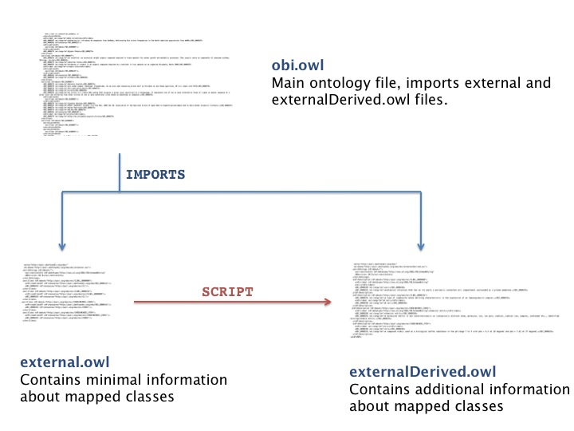
Scripts used by OBI
Perl script
Lisp script

Slide 8
Useful Links
Scripts are available under our SVN repository:
http://purl.obolibrary.org/obo/obi/repository/trunk/src/tools/
add-to-external.pl
http://purl.obolibrary.org/obo/obi/repository/trunk/src/tools/build
create-external-derived.lisp
Detailed tutorial of the scripts:
http://obi-ontology.org/page/Tutorials#MIREOT

Slide 9
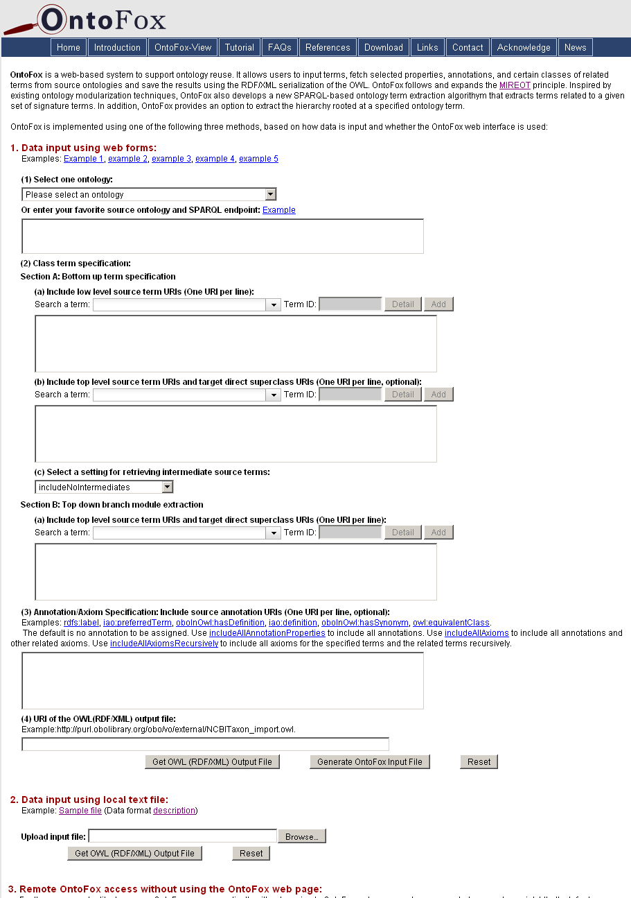
OntoFox: a Web Server for MIREOTing
Based on the MIREOT principle
Web-based data input and output
Output OWL file can be directly imported in your ontology
Easy to use
No programming needed for users
http://ontofox.hegroup.org

Slide 10
Acknowledgements
MélanieCourtot
Frank Gibson
Allyson L. Lister
James Malone
Daniel Schober
Ryan R. Brinkman
Alan Ruttenberg
Zuoshuang(Allen) Xiang
The OBI Consortium

Slide 11
Community View of OBI
Jie Zheng and Yongqun (Oliver) He

Slide 12
OBI
Over 20 different communities involved in development
Each community frequently uses a subset of OBI terms
Each community may have its own community preferred label

Slide 13
Community View
Using specific annotation property
Tag the terms in which a specific community is interested
Provide community-preferred labels
Use of sub property of annotation property ‘alternative term’
FGED alternative term
IEDB alternative term

Slide 14
Implementations
Tag terms using community-specific annotation property
Add annotation property in the terms in obi.owl directly
Mark the terms in a spread sheet
Extract the subset of obi.owl including all related terms and axioms based on specific annotation property
OntoFox-View: OntoFox-based community view generator, ongoing development effort

Slide 15
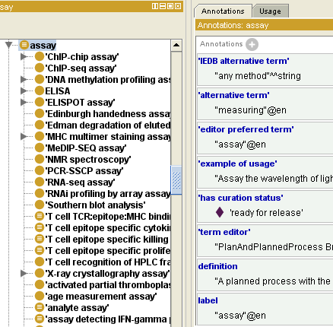
Onto-View
load
RDF store
(obi.owl)
acess
Here will show
the result
Onto-View
IEDB alternative term
obi.owl
Extract terms with ‘IEDB
alternative term’ property and
all the axioms related to them

Slide 16
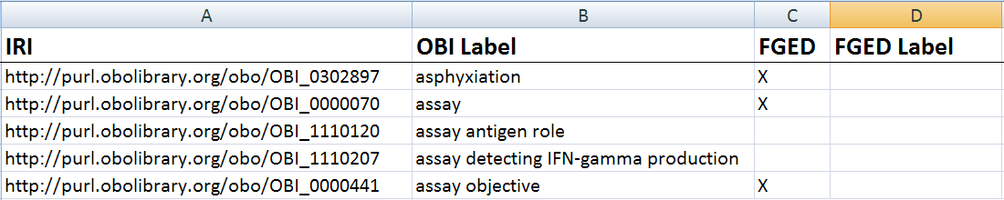
Onto-View
RDF store
(obi.owl)
acess
Here will show
the result
Onto-View
FGED alternative term
1. Add FGED alternative term
property to FGED terms
2. Extract terms with ‘FGED
alternative term’ property and
all the axioms related to them

Slide 17
Acknowledgements
Chris Stoeckert
MélanieCourtot
Bjoern Peters
Alan Ruttenberg
Zuoshuang(Allen) Xiang
The OBI Consortium

